Slide 1
Big Data Analytics(MET CS 777)
Final Term Project
Human Stress Detection (classification)
Vahid Monfared
October 2024
vahidm@bu.edu
1/21

Slide 2

Why is this problem important to solve?
Human Stress Detection: Human stress level detection using physiological data
Humidity – Temperature – Step count – Stress levels” represents the titles for Stress-Lysis.csv file
Importance of Studying This Topic:
Early detection of stress is essential for preventing health issues like cardiovascular disease, immune dysfunction, and mental health disorders.
we can develop non-invasive methods to monitor stress in real time.
2/21

Slide 3
What We Want to Learn from the Data
Determine the relationship between these physiological metrics and stress levels.
Develop a model that can classify stress levels (low, normal, and high) based on the input features.
Evaluate the accuracy of our classification model and understand which physiological factors contribute most to predicting stress levels.
Finding important features
How to use GCP for this kind of dataset to build an application on phone or web base systems
3/21

Slide 4

Machine Learning Models
Logistic Regression (Multinomial / Softmax Regression)
Random Forest Classifier
Decision Tree Classifier
Gradient-Boosted Trees (GBT)
Why These Models?
Suitability in handling numerical tabular data
These models are well-supported in PySpark (Scalability)
Performance Comparison (f1 score, accuracy, precision, recall )
4/21

Slide 5

Expected outcomes
Accurate Stress Classification
Insights for Real-Time Monitoring
Feature Importance for Physicians
Evaluation plan
Accuracy
Precision, Recall, and F1-Score
Confusion Matrix
Cross-Validation: To ensure the model’s robustness and avoid overfitting, I will use k-fold cross-validation to evaluate the model on multiple splits of the data and assess its generalization capability.
5/21

Slide 6

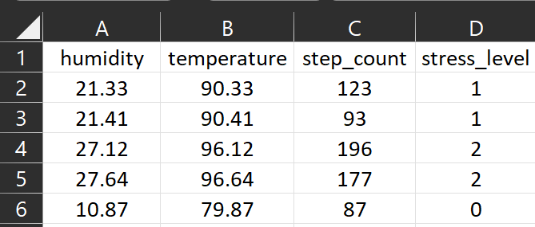
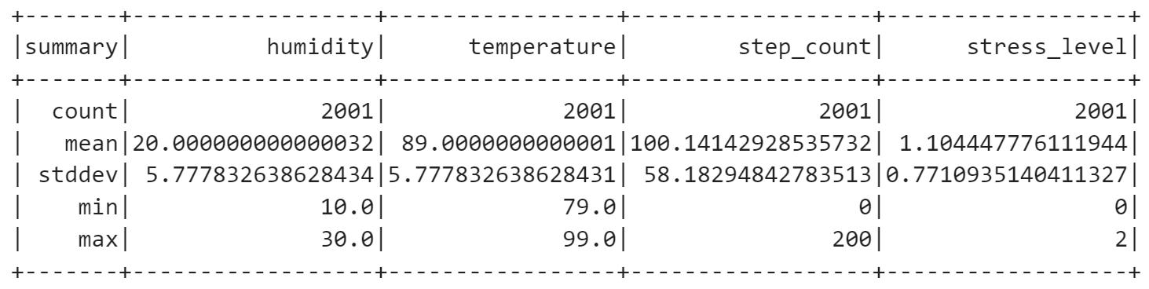
Some samples of dataset
Summary statistics of numerical columns
6/21

Slide 7

Preprocessing and Cleaning
Data Visualization: Utilized to understand data structure and identify anomalies.
Handling Missing Values: Median, KNN imputation exclusively for features
Balancing the Dataset on Labels
Removing Duplicates: Eliminated duplicate entries to maintain data integrity.
Addressing Skewed Data: Used log transformation to correct skewness and approximate normal distribution.
Outlier Treatment: Reduced the impact of outliers through log transformation, Winsorizing, or imputations.
Scaling (Normalizing): Normalized data to ensure consistency across features.
Converting Data Types: Transformed categorical data into numerical formats.
Normal Distribution and Range Checking: Verified data conforms to expected distributions and ranges.
Dropping Unnecessary Data: Removed irrelevant data to streamline the dataset.
7/21

Slide 8
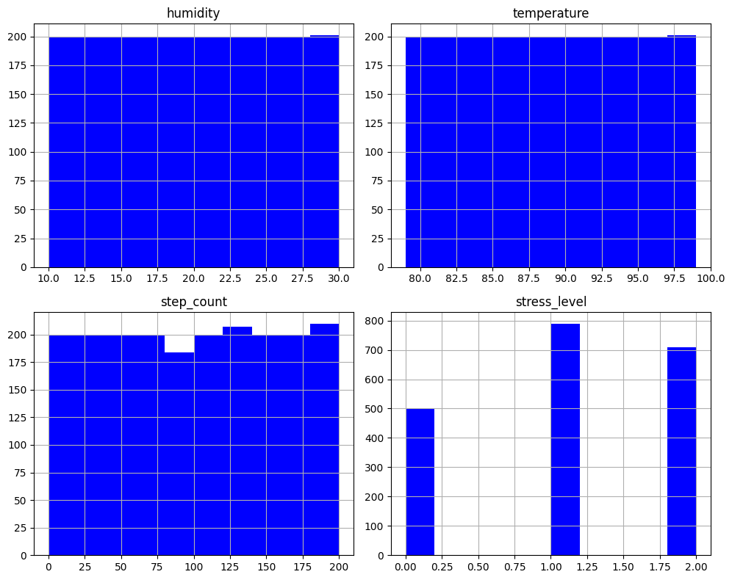
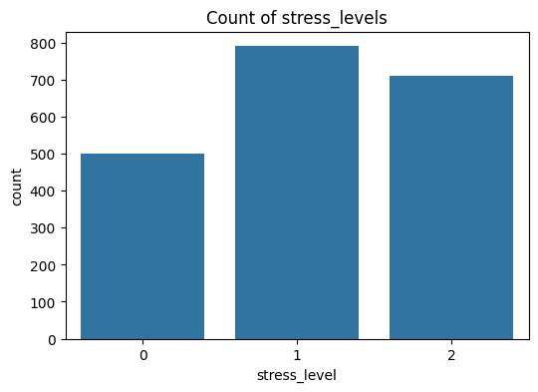
Graphical Presentation of Dataset
The bar plot shows moderate label imbalance, with level 1 having the highest count and level 0 the lowest, suggesting potential label balancing.
8/21

Slide 9
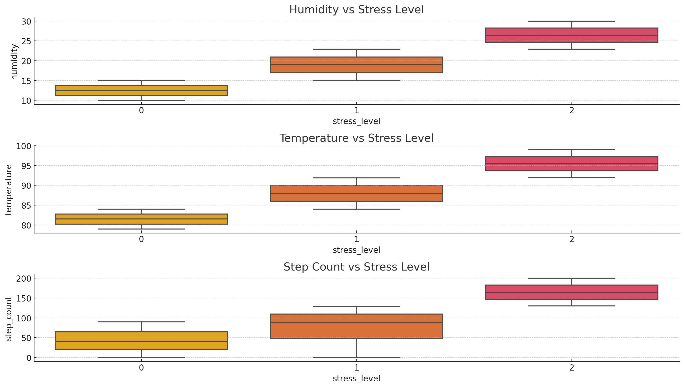
Features vs. Stress Levels
The box plots show that higher stress levels are linked to increased humidity, temperature, and step count, with distinct differences across stress levels.
9/21

Slide 10
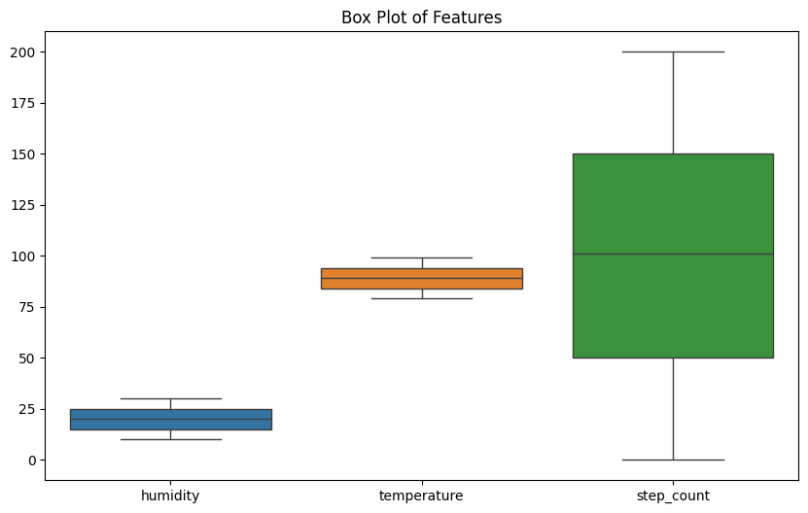
Showing Box Plot
The box plot displays the distribution of three features: humidity, temperature, and step count.
Humidity shows the lowest range, while step count has the largest range and variability with potential outliers; temperature is relatively consistent.
10/21

Slide 11
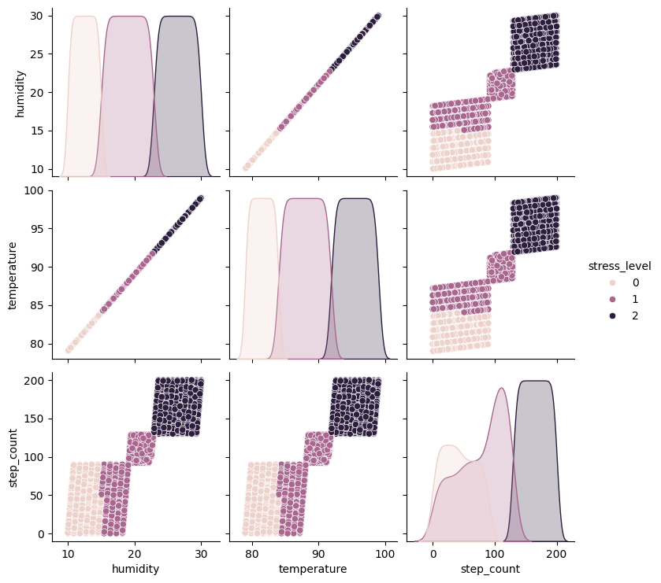
Pair plot for Dataset
The pair plot shows clear separation between stress levels (0, 1, 2) across humidity, temperature, and step count, indicating strong distinctions in the distribution of features for each stress level.
11/21

Slide 12
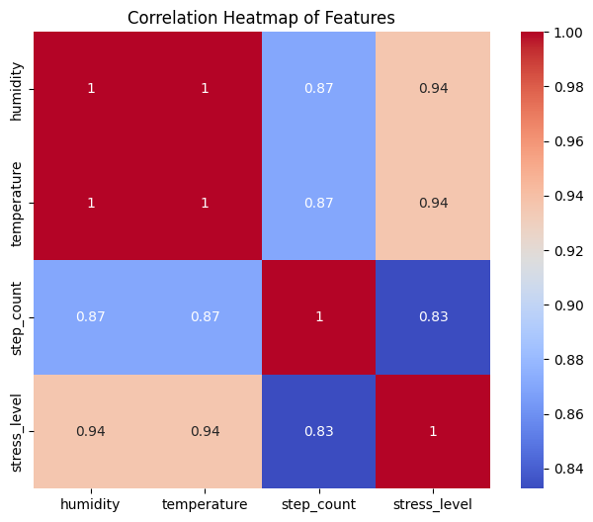
Pearson Correlation Coefficient Heatmap
The heatmap shows strong positive correlations between humidity, temperature, and the ordinal categorical stress level (~0.94), while step count also correlates well with these features (~0.83 to 0.87), indicating high overall feature interdependence.
12/21

Slide 13
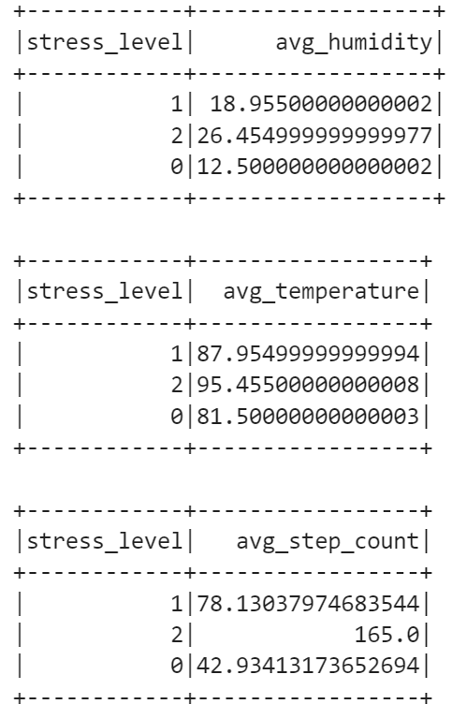
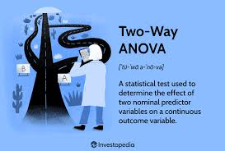
ANOVA for Feature Relationships with the Categorical Label
Higher stress levels correlate with increased humidity, temperature, and step count in this dataset. This relationship suggests that environmental factors and physical activity could influence or reflect the stress levels of individuals.
13/21

Slide 14
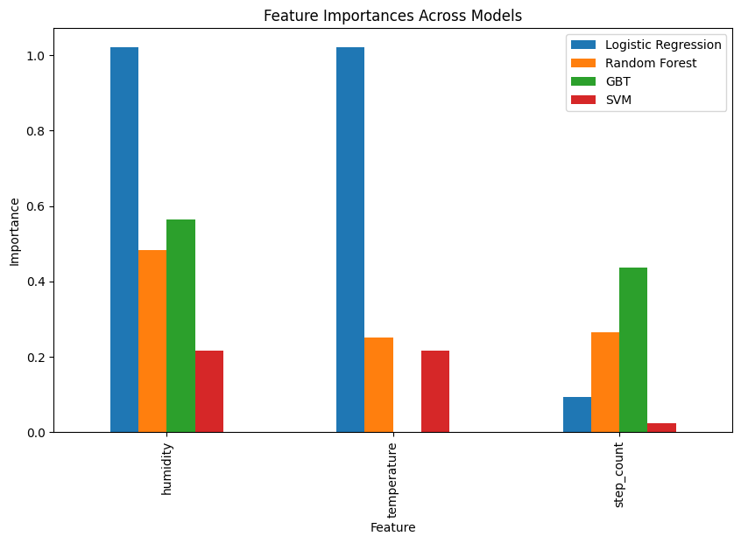
Feature Importance Using Three Methods
The plot shows humidity and temperature as the most important features, especially for Logistic Regression, while step count is more important in GBT and Random Forest. SVM assigns low importance to all features.
As an average across the models, the order of importance is:
Humidity
Temperature
Step Count
Humidity and temperature are the most important features, while step count is less important across the models.
14/21

Slide 15
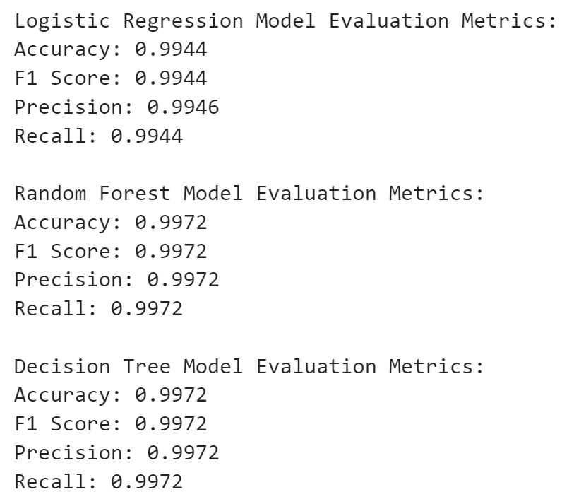
Overall accuracy for three models for classification
The Random Forest and Decision Tree models both achieved higher performance (Accuracy, F1 Score, Precision, Recall: 0.9972) compared to Logistic Regression (Accuracy, F1 Score: 0.9944). All models performed exceptionally well, with minimal differences in evaluation metrics.
15/21

Slide 16
Overall accuracy for three models for classification (tuning, scaling)
Logistic Regression Model Evaluation Metrics:
Accuracy: 0.9988
F1 Score: 0.9988
Precision: 0.9986
Recall: 0.9988
Random Forest Model Evaluation Metrics:
Accuracy: 1.0000
F1 Score: 1.0000
Precision: 1.0000
Recall: 1.0000
Decision Tree Model Evaluation Metrics:
Accuracy: 1.0000
F1 Score: 1.0000
Precision: 1.0000
Recall: 1.0000
After fine-tuning and scaling, both Random Forest and Decision Tree models achieved perfect performance (Accuracy, F1 Score, Precision, Recall: 1.0000), while Logistic Regression also performed exceptionally well with near-perfect scores (Accuracy, F1 Score: 0.9988). These results indicate highly accurate and optimized models.
16/21

Slide 17
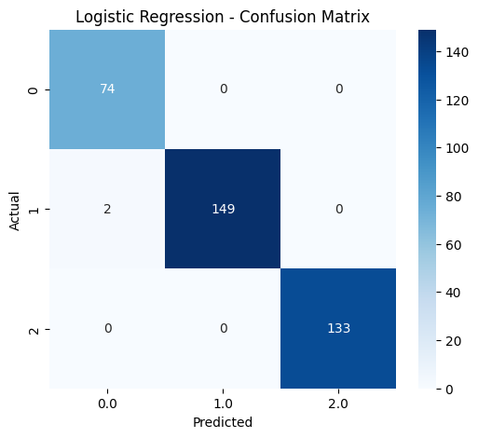


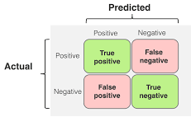
Confusion Matrix for Three Models
Normalized features (logistic regression)
Fine tuning for decision tree
Random forest with no fine tuning
17/21

Slide 18
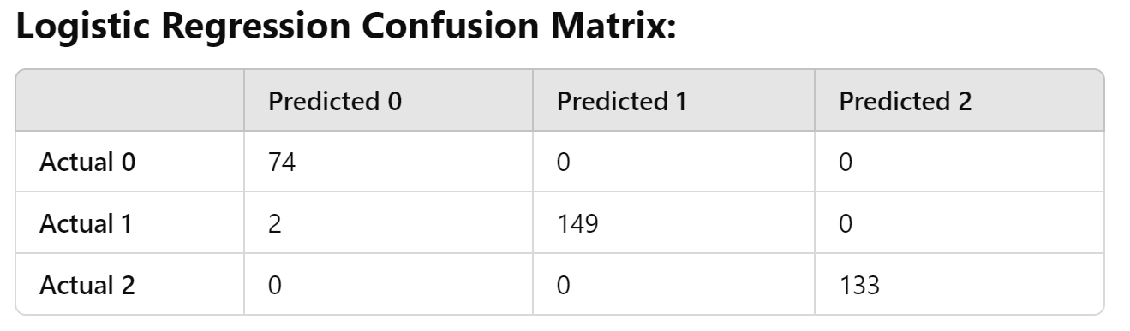
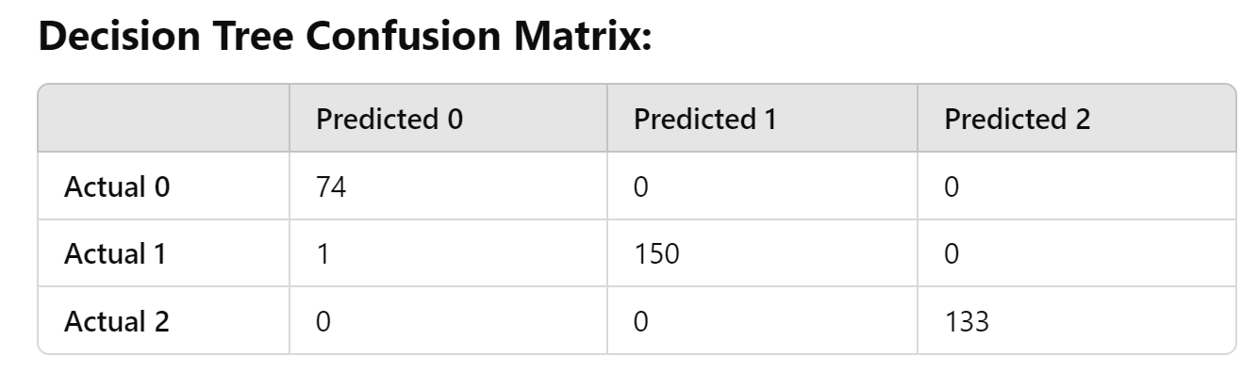
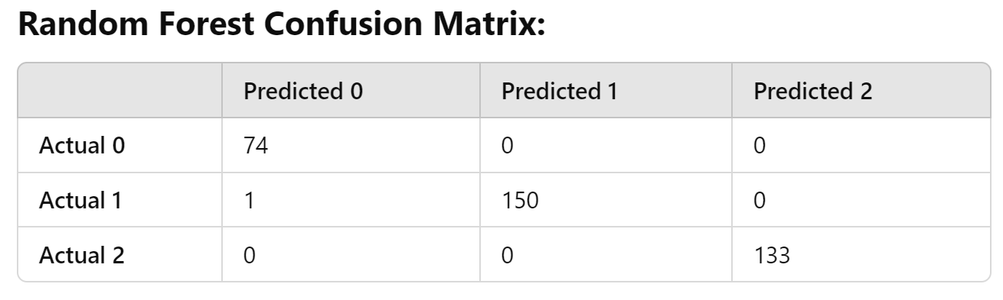
Confusion Matrix
Overall, the most accurate models are as bellow,
Fine tuned random forest
Fine tuned decision tree
Logistic Regression (scaling the features)
18/21

Slide 19
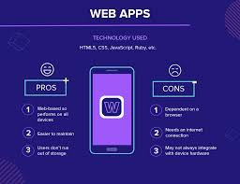
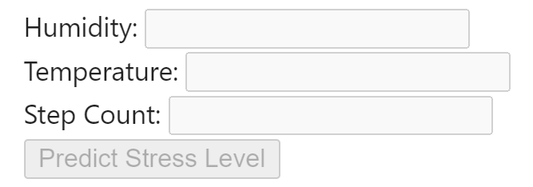
How to Use GCP for This Project
How to convert these models and results for predicting stress levels into a mobile app or website
1. Convert the Model into a Predictive API in Mobile App
2. Create a Website
19/21

Slide 20
Conclusion
Machine learning models can be deployed via a mobile app or website to predict stress levels using real-time data.
This service provides actionable health insights to users and supports physicians in improving patient outcomes.
All four models show nearly identical performance after preprocessing and fine-tuning.
Physicians can use these models as diagnostic tools to track stress levels and prevent stress-related health issues.
Regular monitoring of environment and activity data helps in refining interventions for better health and well-being.
20/21

Slide 21
Thanks for your attention
21/21

